Slide 1

USQ Learning Emporium
Final Project Presentation By: Richard Dobson, Jesse Hare, James McKeown, Vincent Roberts & Ryan Sharp

Slide 2
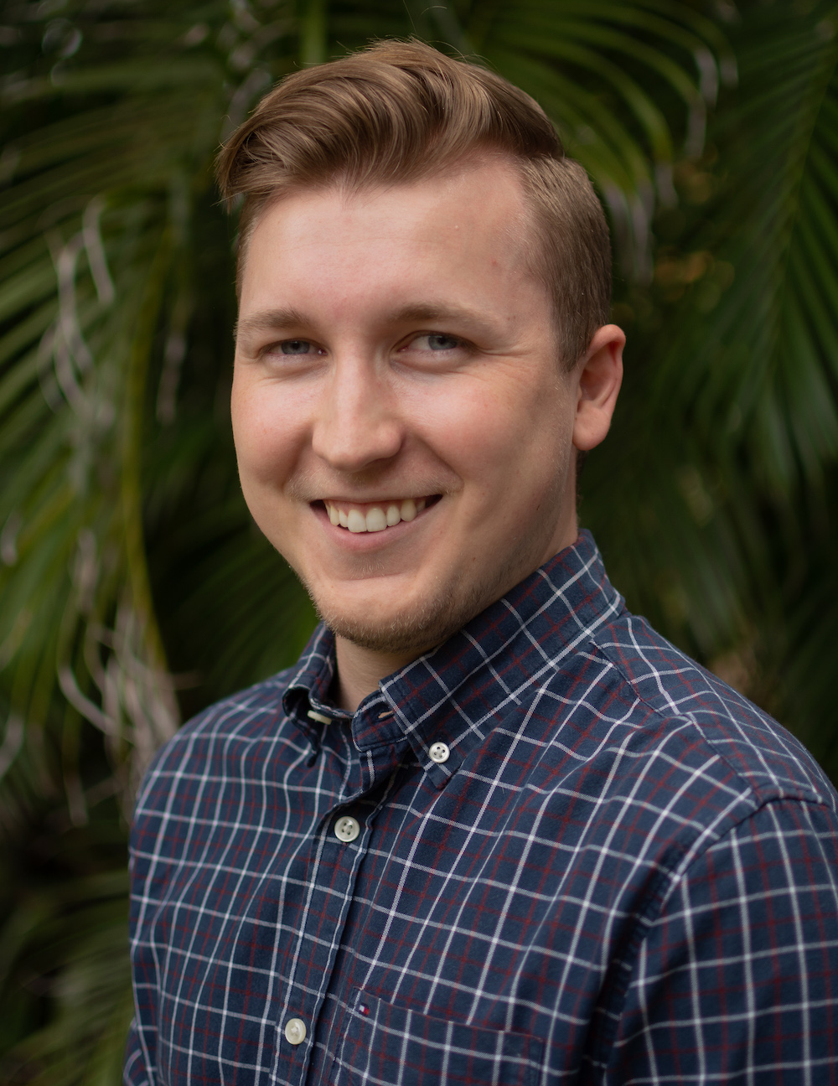
Front-End Development
Myself and Jesse Hare made up the 2 members of the front-end team. We developed the front-end functionality and GUI.
Meet
Ryan Sharp.
Hey there, I’m Ryan Sharp, one of the five members of the USQ Learning Emporium team. I worked on the front-end development of the project and played major roles in the final report and presentation.
Report & Presentation
I played a major role in the development of the final report and presentation.
Front-End Developer
File Metadata Harvester Project
1

Slide 3

Welcome to
USQ Learning Emporium.
Hello and welcome to USQ Learning Emporium! We’re a five-person company from all around Australia. We have two main teams, a front-end team, consisting of Jesse Hare and Ryan Sharp, and a back-end team, consisting of Richard Dobson, James McKeown and Vincent Roberts. On behalf of the whole team, we’d like to thank you for this opportunity to work with you on this exciting project!
USQ Learning Emporium

Slide 4

Our Journey
So Far
Initial Consultation & Planning
Our journey began by having multiple client meetings to explore and discover what your needs were.
Over the past three months, our team at the USQ Learning Emporium has worked tirelessly to create an exceptional final product. This is only the beginning of our journey that we hope to continue with you.
Development & Iterations
From these meetings, our team got straight to work developing your program. During this time, we met with you to provide updates on our progress.
Client Presentation & Report
That brings us to today! We’re excited to finally share our work with you. The following presentation will run you through our progress to date.
100%
Complete
100%
Customer Satisfaction
1

Slide 5

Back-End Development.
Task Number One
Develop a CLI script that takes a directory path as input, and returns (on STDOUT) a CSV-formatted text having one line per file in the directory, and listing all metadata attributes and values extracted from that file.
1

Slide 6
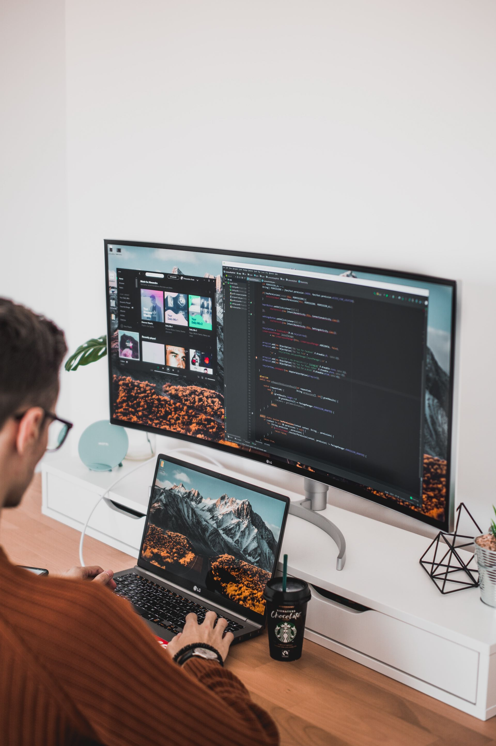
Front-End Development.
Task Number Two
Develop a GUI that reads the CSV file (provided by the back-end script) and display a spreadsheet-like grid, where rows can be sorted and filtered on attribute values, files can be searched for on multiple criteria, and double-clicking a file-row opens it.
1

Slide 7

01. Extracts Directory Information Into CSV
The main goal of the program is to extract information from a specific directory and its sub directories. Our back-end team worked extensively to make sure this worked as desired.
About
The Product.
02. Front End Reads The CSV File
From this CSV file presented by the back-end program, the front-end program then needs to be able to read this. Our front-end team worked on this functionality.
Throughout the development of the project we wanted to ensure three key features were implemented. We have listened to your recommendations and believe these are the most important features in the program.
03. GUI Displays The CSV File
Once the front-end program has read the CSV file, it’s time to show that information to the user. The information is displayed in a spreadsheet-like grid to promote user experience.
1

Slide 8
Three Key
Features & Benefits.
How our program can help your business succeed.
Intuitive
The front-end GUI program allows users the ability to search and sort through all file types. You can even open the files from inside the window!
Ease-of-Use
The front-end GUI is the place the user is going to spend the most time, so we made sure it can be easily navigated with easy-to-use buttons and menus.
Reliability
The back-end team has worked tirelessly to ensure the product works as expected. Through their testing we believe our product is up to standard.
1

Slide 9
Analysis & Implementation
Presented By: Vincent Roberts

Slide 10
Back-End Development
Myself, Richard Dobson and James McKeown made up the 3 members of the back-end team.
Meet
Vincent Roberts.
Hey there, I’m Vincent Roberts, one of the five members of the USQ Learning Emporium team. I worked on the back-end development of the project, focusing on developing the functionality for a variety of file types, as well as program testing.
Functionality Development
I played a major role in development of the program back-end, including functionality and testing.
Back-End Developer
File Metadata Harvester Project
1

Slide 11
Project Aim Metadata Scraping
Client wished to have a utility to help them organize a large number of files.
They needed this to be focused around scraping file metadata and displaying it in an intuitive and easy to use format.
Access to this metadata in a user-friendly way would assist them in then being able to organize their files.

Slide 12
Project Aim Metadata Scraping
This mean they had some particular focuses for this uitlity:
Needed to be able to handle different file types.
Needed to be able to display collected metadata in a GUI.
Needed to be able to manipulate the search results in order to view it in different ways.

Slide 13
Requirements Gathering
Requirements gathered through client meetings.
Initial meetings were held to gather overall requirements and initial priorities.
Subsequent meetings were also held to refine these requirements, as well address any additional requirements or changes as development continued.

Slide 14
Requirements
Was to be developed in Python
Was to be primarily working on a linux OS
Was to be invoked through a CLI, taking a path entered by the user
Output of scraped metadata exported into a CSV file
GUI to read this CSV file

Slide 15
GUI Requirements
GUI needs to be able to organize metadata based on user input
Able to sort by attributes
Able to sort based on multiple criteria
Able to open a file when double clicked

Slide 16
Meeting These Requirements
Agile approach to development was taken
Development team was split into two sub-teams
Each team focused on the front or back end of the project, developing both in parallel
Iterations of the project were presented to the client over several meetings for feedback

Slide 17
Implementation
Implemented with Python
Implemented on a Linux based OS
Uses a number of external libraries
Hachoir external library
PyPDF2 external library
OS Python module

Slide 18
Costings, Findings
& Recommendations
Presented By: James McKeown

Slide 19
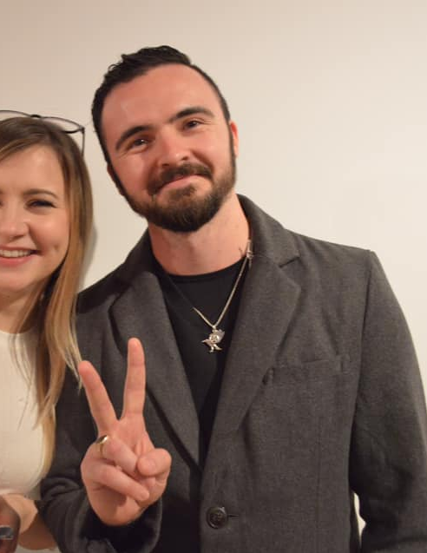
Back-End Development
Myself, Richard Dobson and James McKeown made up the 3 members of the back-end team.
Meet
James McKeown.
Hey there, I’m James McKeown, one of the five members of the USQ Learning Emporium team. I worked on the back-end development of the project and played a major role in the back-end development of the project, specifically the directory traversal, command-line argument parsing and CSV output functionalities.
Programming
I played a major role in the back-end development of the project, specifically the directory traversal, command-line argument parsing and CSV output functionalities.
Back-End Developer
File Metadata Harvester Project
17

Slide 20
Hardware
Costing.
Hardware Used | # of Items Used | Cost ($AUD) | Total Cost ($AUD)
Microsoft Surface Pro 6 | 5 | $1,349 | $6,745
MacBook Air 13” (128GB) | 1 | $1,699 | $1,699
As the project was worked on remotely, all team members required company issued equipment. There were a total of 5 Window machines provided to each member, with an additional MacBook Air provided to the project leader, James McKeown.
17

Slide 21
Software
Costing.
Software Used | # of Accounts Needed | Cost ($AUD) | Total Cost ($AUD)
Anaconda | 2 | $0 | $0
Atom (IDE) | 5 | $0 | $0
Facebook Messenger | 5 | $0 | $0
Slack | 5 | $0 | $0
Spyder (IDE) | 2 | $0 | $0
Zoom Video Conferencing | 5 | $0 | $0
Communication and rapid development facilitated by Slack
Client meetings hosted by Zoom video conference software
Atom with its multi-programmer ability and multi-OS flexibility for code editor
VirtualBox for testing on multiple operating systems
Python for multi-OS interoperability and low system overhead and requirements
17

Slide 22
Time
Costing.
Sprint # | Weeks to Complete
1 | 1
2 | 3
3 | 3
4 | 3
5 | 2
The project ran for a total of 12 weeks. Within these 12 weeks, there were five sprints ranging from 1-week to 3-week sprints. These can be seen in the table to the right.
17

Slide 23
Labor
Costing.
Team Member | Role | Hourly Rate | Hours Per Week | Total Weeks Worked | Total Cost ($AUD)
James McKeown | Team Leader/Back-End Developer | $39.90 | 20 | 12 | $9,576
Jesse Hare | Front-End Developer | $34.10 | 20 | 12 | $8,184
Richard Dobson | Back-End Developer | $35.40 | 20 | 12 | $8,496
Ryan Sharp | Front-End Developer | $34.10 | 20 | 12 | $8,184
Vincent Roberts | Back-End Developer | $35.40 | 20 | 12 | $8,496
As stated previously the team was split into two teams, a front-end team and a back-end team. All labor costing are based on industry standards.
17

Slide 24
Project Methodology.
The methodology the team used to complete the project was the AGILE methodology.
The main tasks were developed from day three to seven.
Regular meetings with clients at end of each sprint to re-asses requirements.
Milestones hit at the end of each sprint for review.
17

Slide 25
Product Demonstration
Presented By: Jesse Hare

Slide 26
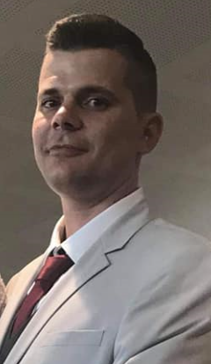
Front-End Development
Myself and Ryan Sharp worked together on the Front-End design and development.
Meet
Jesse Hare.
Hey there, my name is Jesse Hare. I am part of the Front-End team for USQ Learning Emporium. Myself and Ryan Sharp were responsible for the design and development of the File Metadata Searcher GUI.
Full-Stack Integration
I was responsible for testing between the core components and ensuring that they communicated in the right format.
Front-End Developer
File Metadata Harvester Project
17

Slide 27

File Metadata Harvester
& Searcher.
An invaluable utility for extracting file metadata for display in an intuitive, feature packed user interface.
Intuitive Design Solution
Core Components and Features
17

Slide 28
The Metadata Harvester.
The Metadata Searcher GUI.
Component #1
Conducts a search in a specified directory, extracting metadata from a broad spectrum of file types.
Component #1
Takes output from the Harvester program and displays in a feature packed GUI.
Component #2
File metadata extracted is then formatted into a CSV file for use by the Searcher GUI.
Component #2
Enables searching, sorting and filtering of file metadata against multiple fields at once.
Component #3
User can also open files from within the GUI.
17

Slide 29
Metadata Harvester Features.
Search for file metadata is targeted at a specified directory
User has the option to perform a recursive search-this will also search all subdirectories within the specified directory and extract file metadata
Extracts metadata for a range of file types, included but not limited to: 'bzip2','cab','gzip','mar','tar','zip','aiff','mpeg','real_audio','sun_next_snd','matroska','ogg','real_media','riff','bmp','gif','ico','jpeg','pcx','png','psd','targa','tiff','wmf','xcf','ole2','pcf','torrent','ttf','exe','asf','flv','mov’,’pdf’ and many more
Outputs all harvested metadata to a user-specified csv file
17

Slide 30
Metadata Searcher Features.
Tabular display of file records and their metadata
User can refine what is displayed through he following operations:
i. Sorting – File records can be sorted by any individual metadata field, in ascending or descending order
ii. Searching – User can search for records that match particular conditions based on the value of particular metadata fields
iii. Filtering – The file records displayed can be filtered by multiple metadata fields at once, allowing a large degree of control when trying to search for a particular file/or group of related files
<number>

Slide 31

Metadata Harvester
& Searcher Demonstration

Slide 32
Presentation Conclusion
Presented By: Richard Dobson

Slide 33
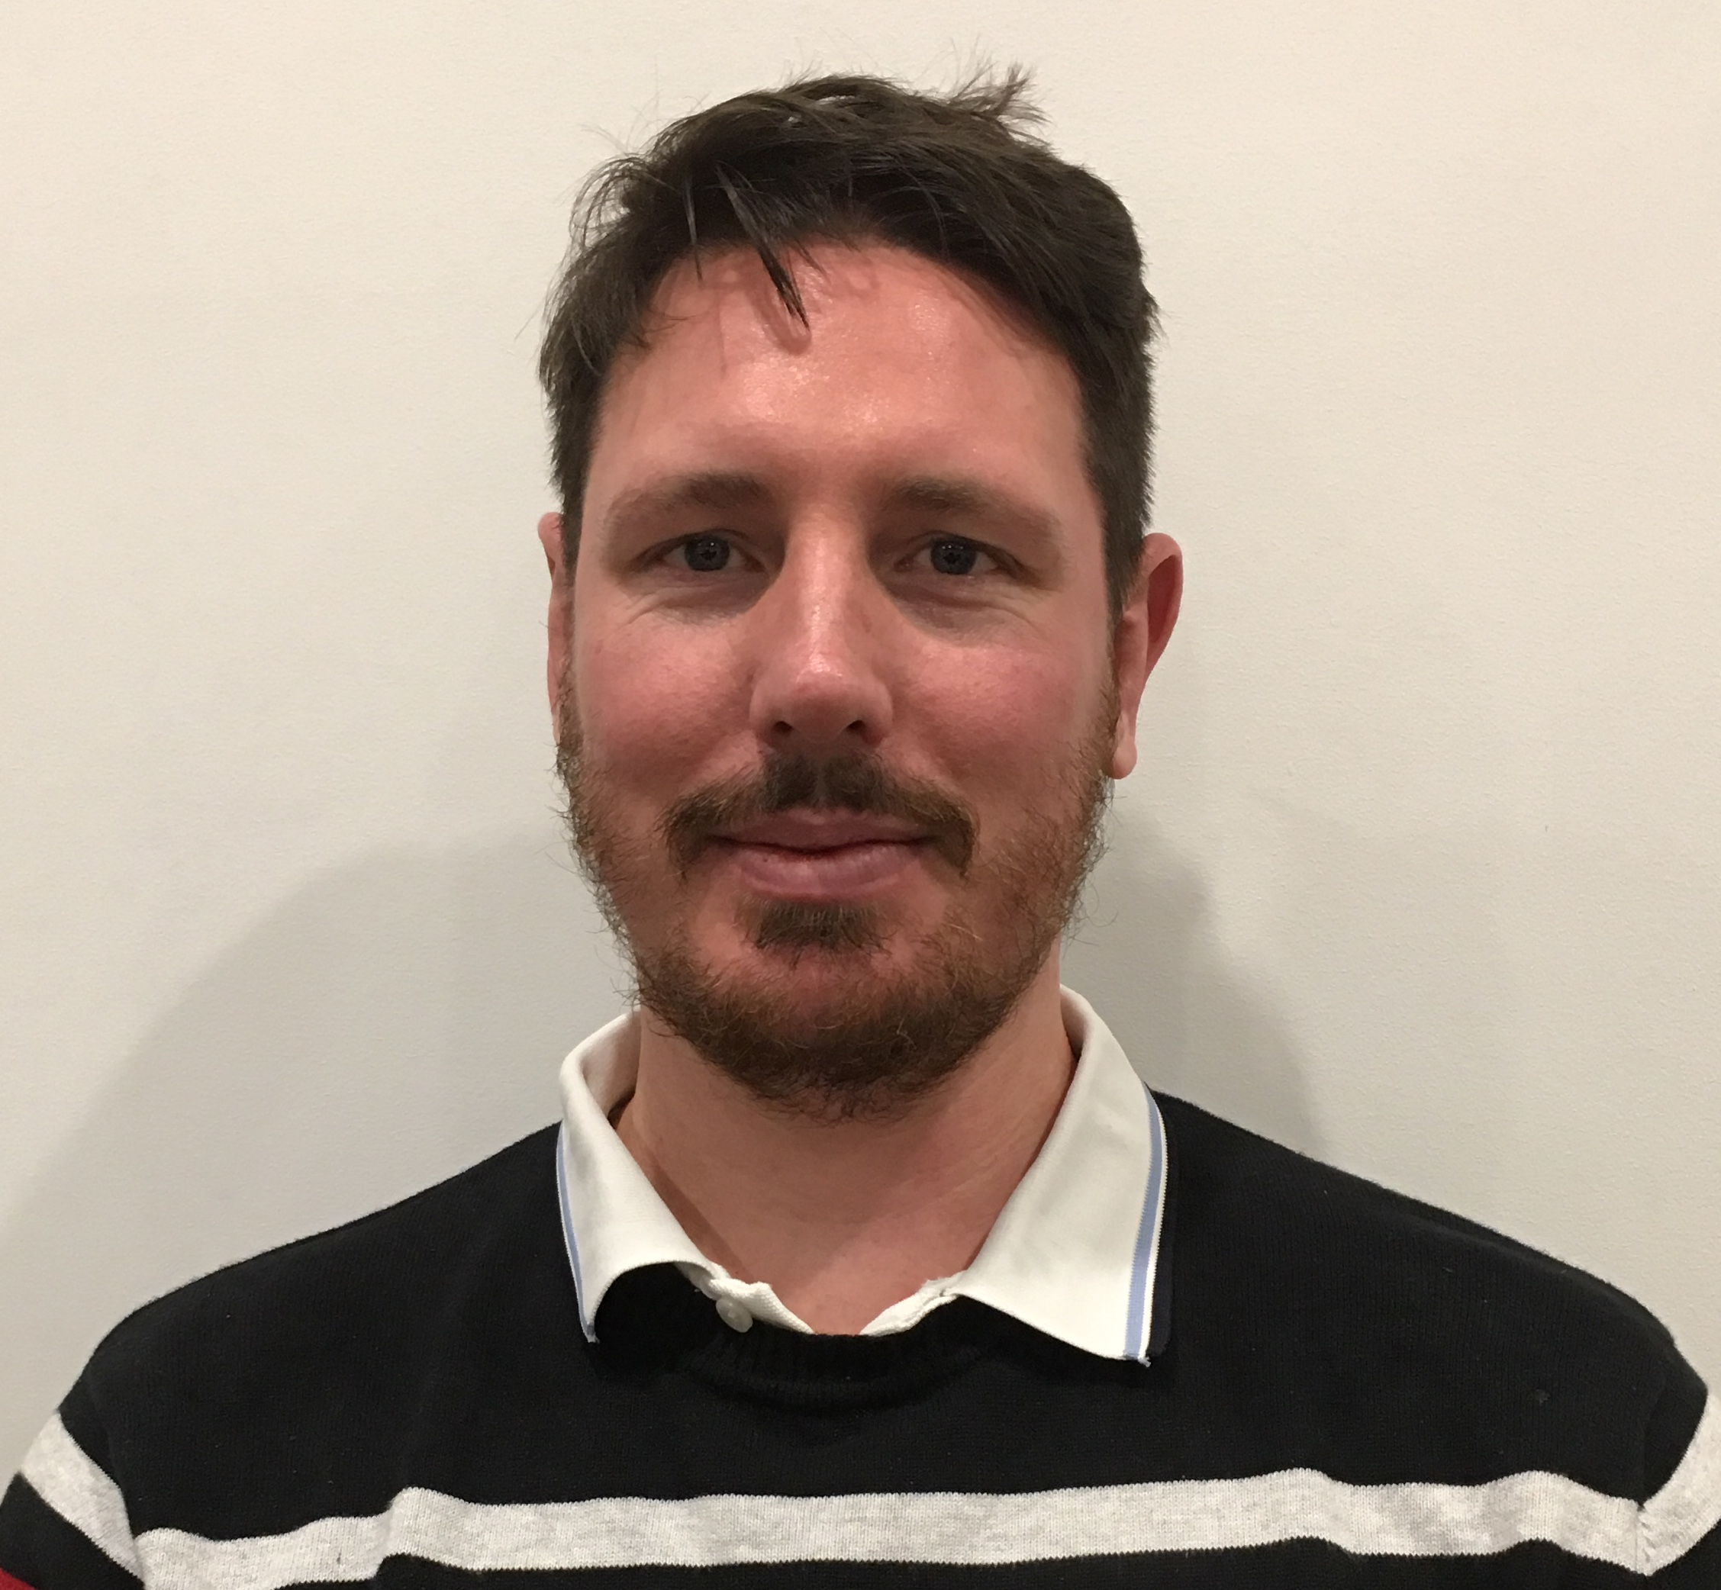
Back-End Development
Myself, James McKeown, Vincent Roberts made up the 3 members of the back-end team.
Meet
Richard Dobson.
Hey there, I’m Richard Dobson, one of the five members of the USQ Learning Emporium team. I worked on the back-end development of the project and was responsible for the research of the back-end program.
Research
I was responsible for researching potential open-source methods of extracting file metadata on the command line, and then helping to implement the python libraries that were ultimately chosen.
Back-End Developer
File Metadata Harvester Project
<number>

Slide 34

Should You Invest?
Yes!
Because the metadata extraction and searching capabilities in this program have so many applications for cybersecurity
Global cybersecurity spending predicted to exceed $1 Trillion over the 5 years 2017-2021 (Cybercrime Magazine, 10/06/2019)
BEMIND
$1 Trillion
Projected Monetary Growth
5 Years
Projected Growth
<number>

Slide 35

Future Improvements
Back-End.
Front-End.
Improvements:
Multi-threaded performance
Use existing .csv as input file
ASCII progress bar in CLI
Increased support for atypical/ non-media file types
Support for MacOS and Win 10
Better cmd line error handling
Improvements:
Multi-threaded performance
Use existing .csv as input file
ASCII progress bar in CLI
Increased support for atypical/ non-media file types
Support for MacOS and Win 10
Better cmd line error handling
<number>

Slide 36


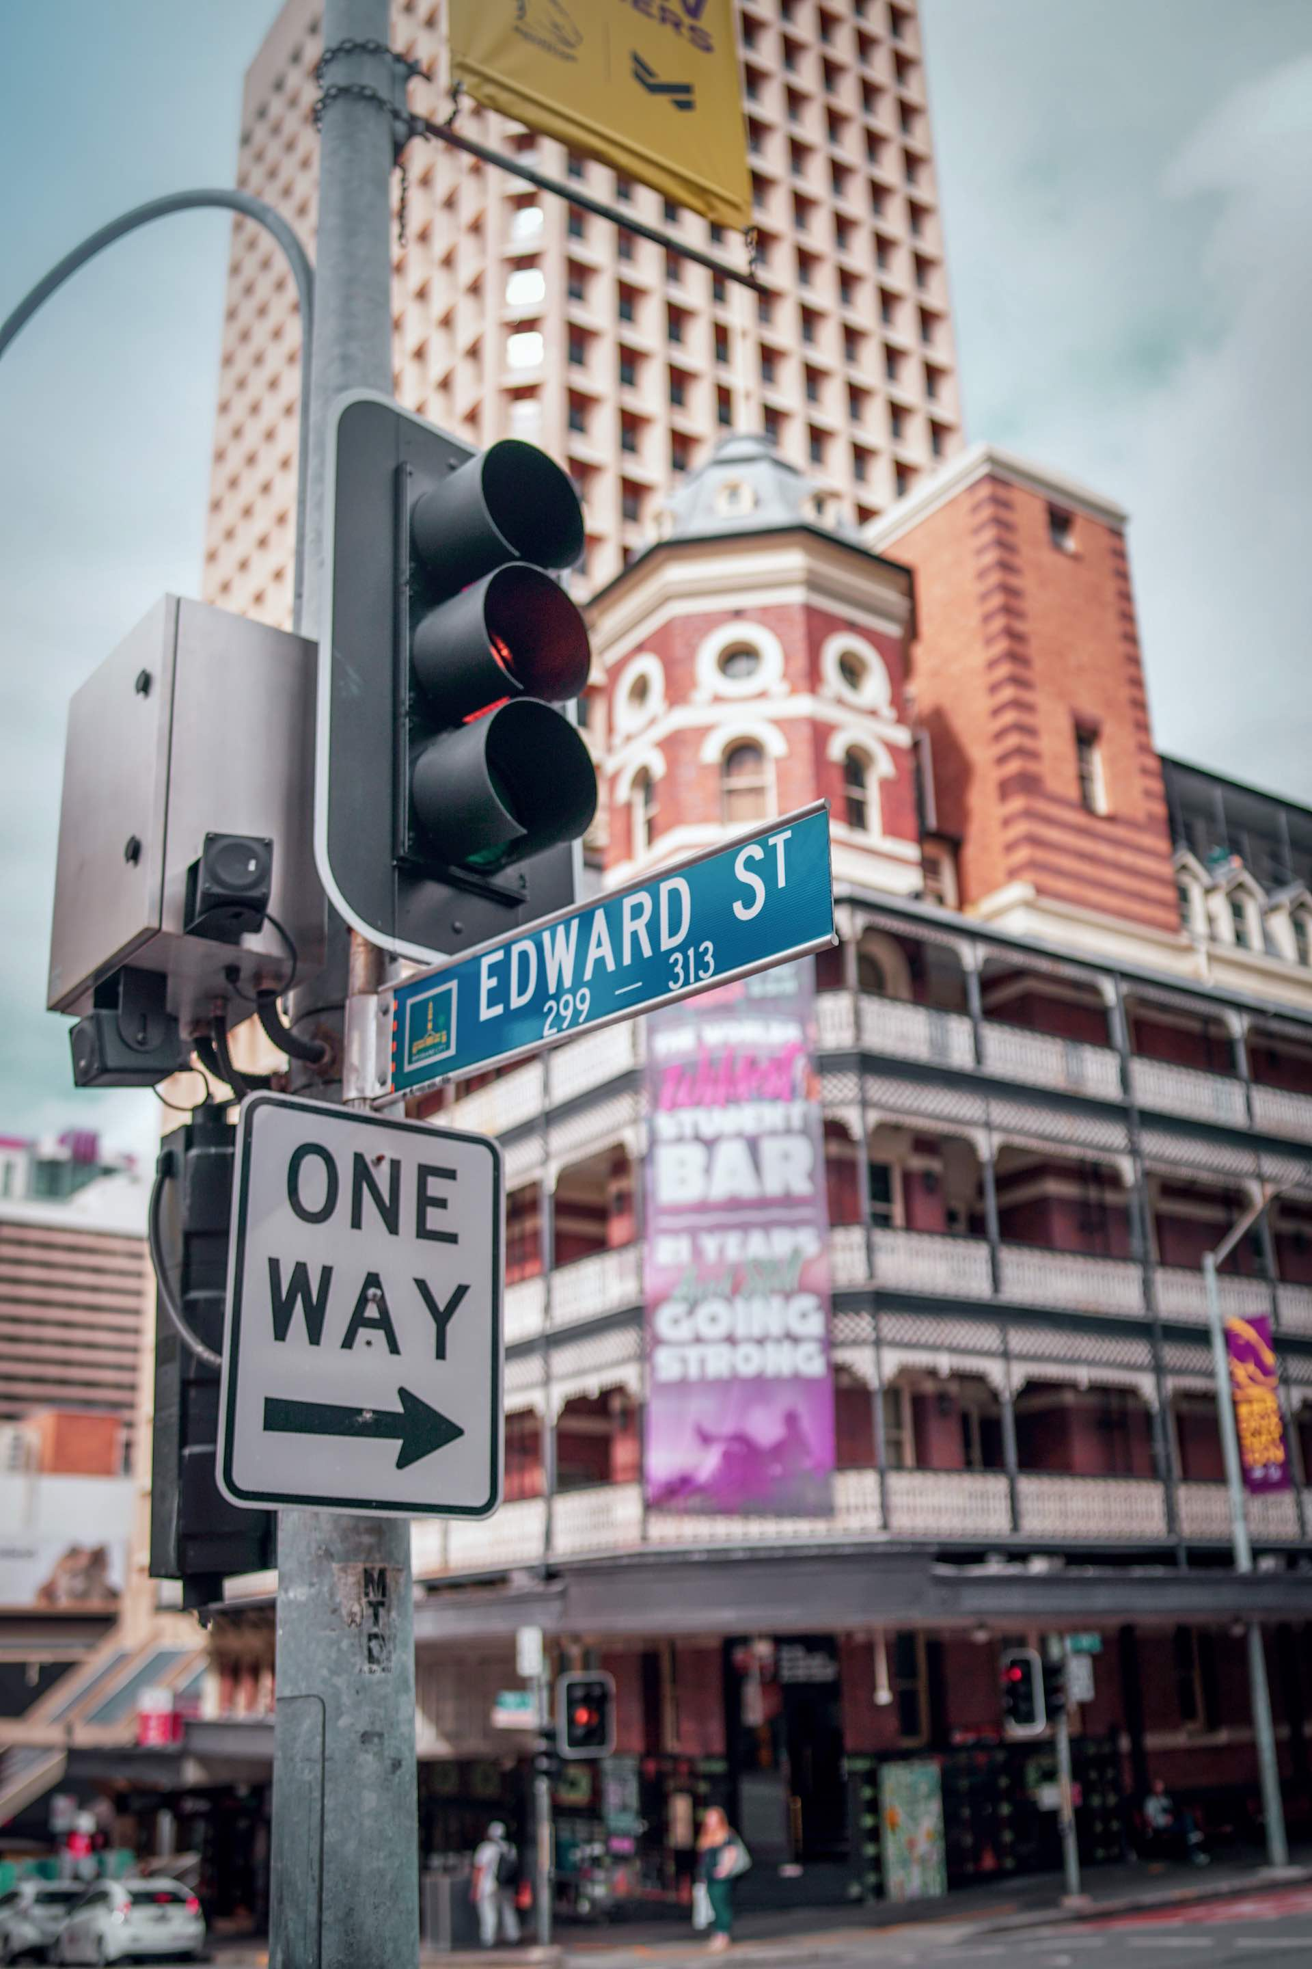
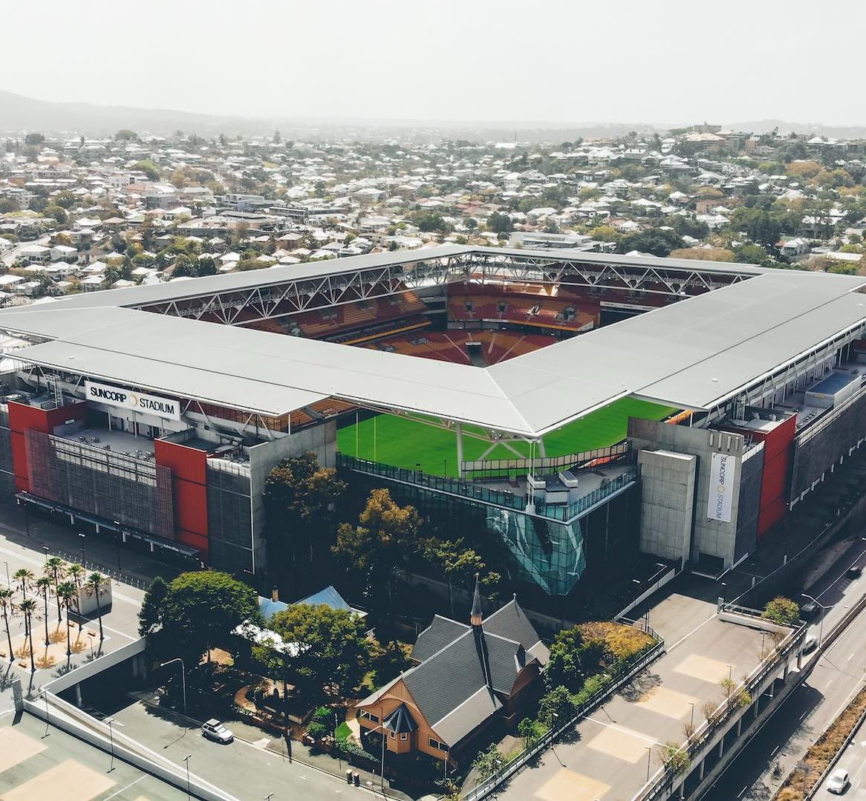
Company Vision.
We’re a fast-growing tech start-up founded in Brisbane, Queensland and have big plans for the future. We have office locations all around the world and plan to expand to even more countries in the coming financial year.
We also boast cutting edge file detection and attribute harvesting capabilities, as shown in this presentation. We also have industry-leading GUI and CLUI design with functionality expanding to Mobile, Cloud, SAAS and Big Data…
20k
Facebook
12k
Instagram
8k
LinkedIn
Follow Us!

Slide 37

Thank You!
On behalf of USQ Learning Emporium, thank you for the opportunity to deliver this project. We’ve all learned a lot over the past 3 months, and we look forward to using the knowledge gained for the next iteration. We’re not done yet!
<number>

